Slide 1

Atomic Simulation Environment
Souheil Saadi
saadi@fysik.dtu.dk
Thomas Olsen
tolsen@fysik.dtu.dk
Jens Jørgen Mortensen
jensj@fysik.dtu.dk
Ask Hjorth Larsen
askhl@fysik.dtu.dk
Notes:
Changes by Ask Hjorth Larsen February 20 2009
Conversion from ppt to odp
Examples updated to GPAW trunk rev 3224, ASE trunk rev 795

Slide 2
Atomic Simulation Environment
Toolbox for :
Building atomic structures
Molecular Dynamics
Structure optimization
Analysis
Interface to several calculator codes:
GPAW, ASAP, Dacapo...

Slide 3
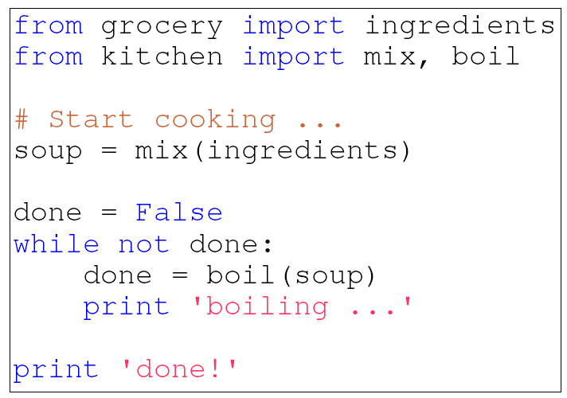
The Python programming language http://www.python.org/

Slide 4
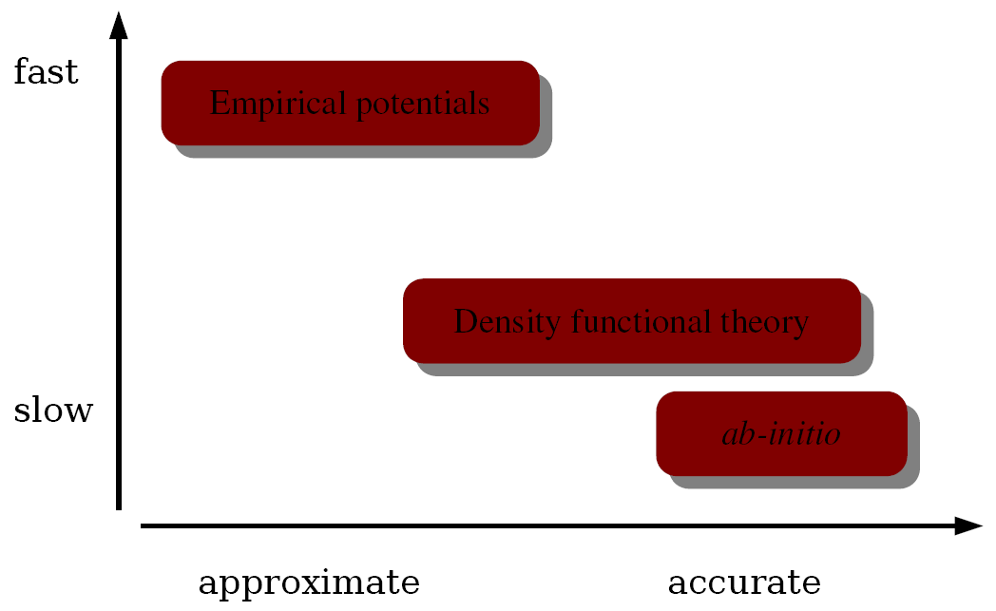
Energy Calculations

Slide 5
ASE Objects

Slide 6
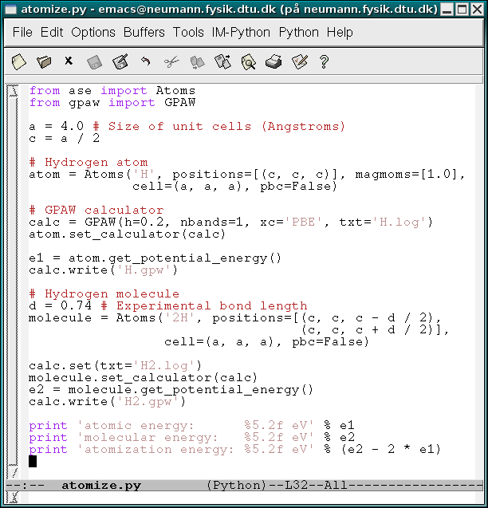
Demonstration
Atomization energy of a H₂ molecule
[askhl@neumann ~]$ python atomize.py
atomic energy: -0.74 eV
molecular energy: -6.35 eV
atomization energy: -4.86 eV

Slide 7
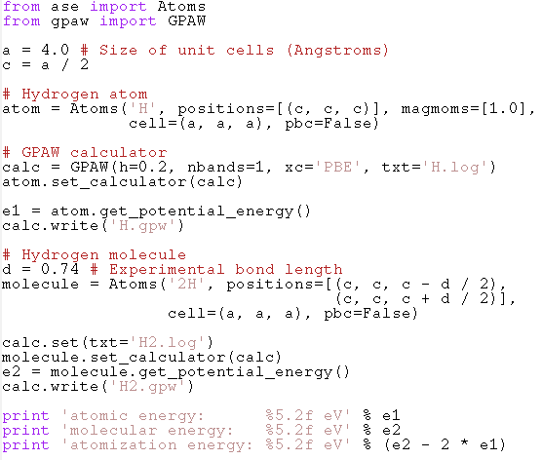
Script
Notes:
from ase import Atoms
from gpaw import GPAW
a = 4.0 # Size of unit cells (Angstroms)
c = a / 2
# Hydrogen atom
atom = Atoms('H', positions=[(c, c, c)], magmoms=[1.0],
cell=(a, a, a), pbc=False)
# GPAW calculator
calc = GPAW(h=0.2, nbands=1, xc='PBE', txt='H.log')
atom.set_calculator(calc)
e1 = atom.get_potential_energy()
calc.write('H.gpw')
# Hydrogen molecule
d = 0.74 # Experimental bond length
molecule = Atoms('2H', positions=[(c, c, c - d / 2),
(c, c, c + d / 2)],
cell=(a, a, a), pbc=False)
calc.set(txt='H2.log')
molecule.set_calculator(calc)
e2 = molecule.get_potential_energy()
calc.write('H2.gpw')
print 'atomic energy: %5.2f eV' % e1
print 'molecular energy: %5.2f eV' % e2
print 'atomization energy: %5.2f eV' % (e2 - 2 * e1)

Slide 8
Simple example:
CO on Cu(100)
Part II

Slide 9
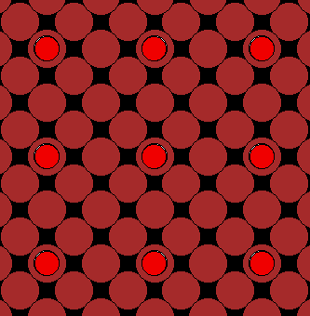
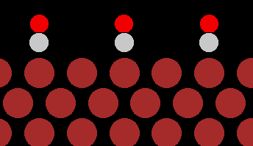
Example: CO/Cu(100)
Calculate adsorption energies for the p(2x2) structure using the PBE functional.
This will be done by means of a structure relaxation.
  Calculate forces, move atoms in general direction of forces, repeat until geometry converges.
Experimental value: 0.53 eV - 0.57 eV

Slide 10
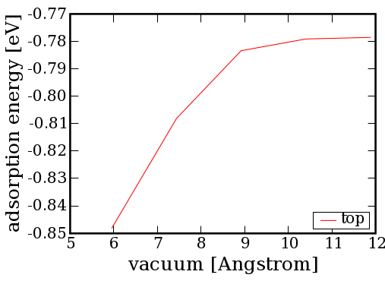
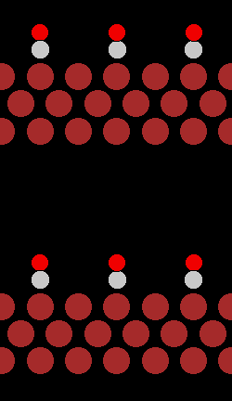
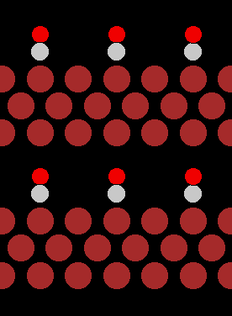
How much vacuum?

Slide 11
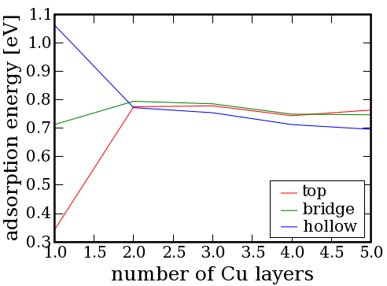
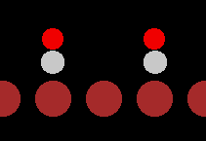
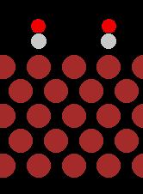
How thick should the slab be?

Slide 12
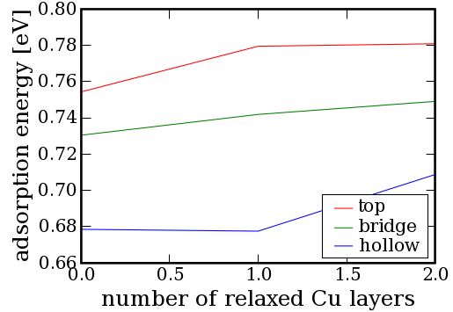
Surface relaxations

Slide 13
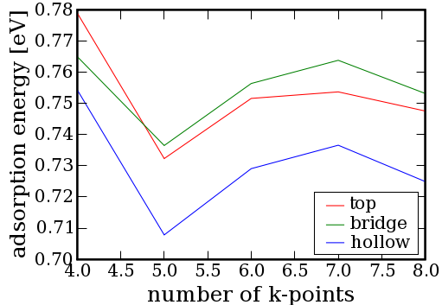
Number of k-points
The 2D surface Brillouin zone is sampled uniformly with NxN points.
GPAW language:
kpts=(N, N, 1)

Slide 14
Useful Software and Websites
Part III

Slide 15
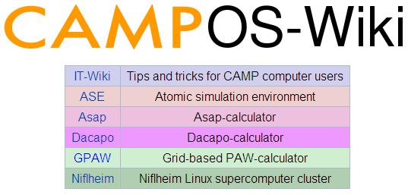
https://wiki.fysik.dtu.dk
Exercises can be found on
GPAW-> Exercises

Slide 16
Software
Python – The language that ASE uses
http://www.python.org and
Scientific Python – Addon with nice tools
http://www.scipy.org
Jmol – Java based molecular viewer
http://jmol.sourceforge.net/download/
VMD – Multiplatform Visualization tool
http://www.ks.uiuc.edu/Research/vmd/

Slide 17

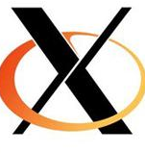

Software for remote access
You need a SHELL and X11
Putty: http://www.chiark.greenend.org.uk/~sgtatham/putty/
Xming:
http://sourceforge.net/projects/xming
OSX and GNU/Linux run X11 and terminals natively
Use your Campusnet login to connect to bohr.gbar.dtu.dk
Example:
ssh -X s021864@bohr.gbar.dtu.dk

